Slide 1
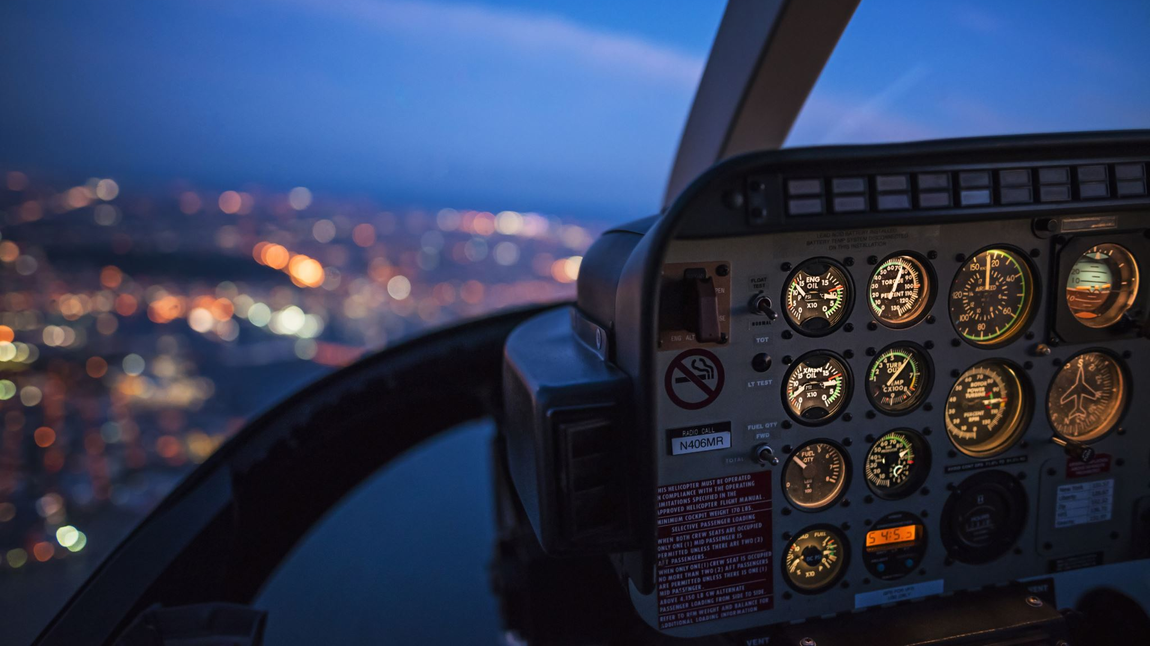
British Airways Reviews
A sentiment analysis on reviews from British Airways by AMETI’OBONG USIFOH

Slide 2
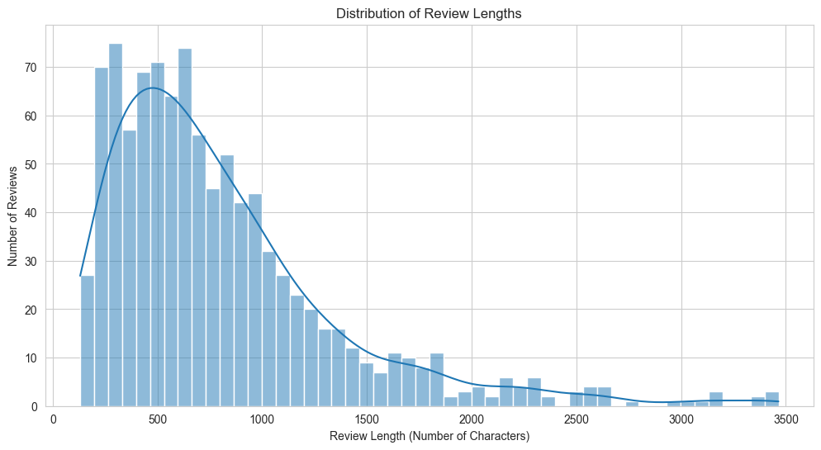
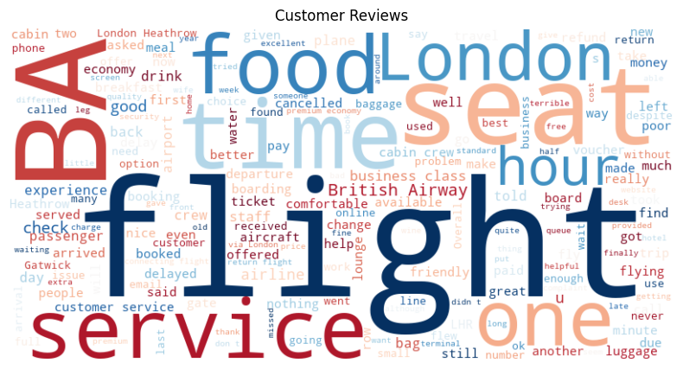
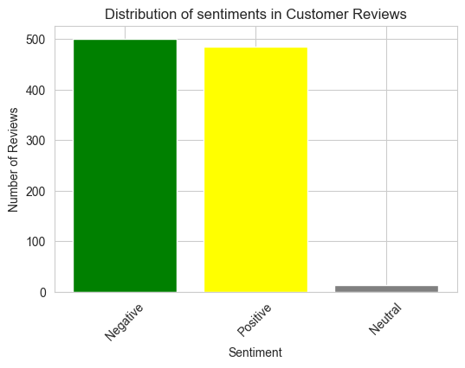
SUMMARY OF SENTIMENT ANALYSIS
Distribution of characters in 1000 reviews
Wordcloud of Customer of Reviews
Distribution of Reviews
End-to-End analysis of reviews from British Airways
Findings:
1000 reviews, no missing values, average review length of approximately 800 characters
Most reviews ranging from 200 to 1200 characters and some beyond 2,000 characters
A higher number of negative reviews (>500 negative sentiment – 54%)
Positive reviews are slightly lower (<500 positive sentiments – 41%)
A small portion of neutral reviews (<50 neutral sentiments – 2%)
A wordcloud showing frequency of words in the dataset
Link to Github for full analysis: GITHUB

